Slide 1
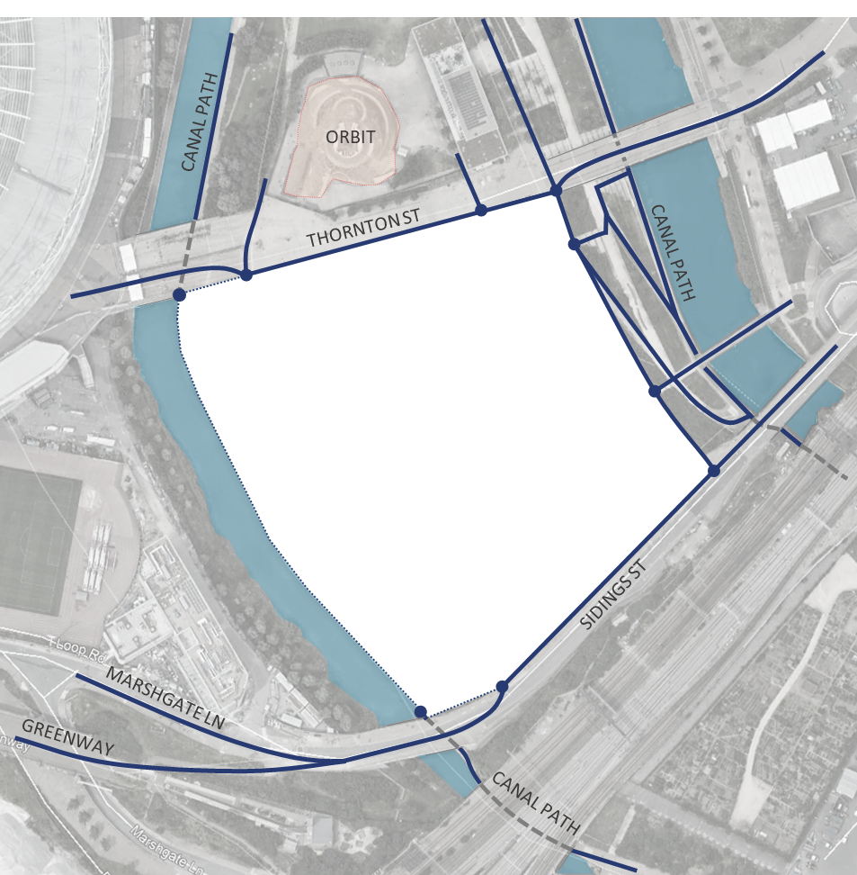



[CLICK ON THE IMAGE FOR INFORMATION]
35%
% OF TOWERS NEAR CANAL
35%
% OF PUBLIC AREA NEAR CANAL

Slide 2



[CLICK ON THE IMAGE FOR INFORMATION]
35%
YOUR RESIDENTIAL IS LOCATED NEAR RAILWAY
RAILWAY TRACKS

Slide 3
[CLICK ON THE IMAGE FOR INFORMATION]
35%
YOUR RESIDENTIAL IS LOCATED NEAR RAILWAY
RAILWAY TRACKS

